Slide 1
DATAGRAM NETWORKS
In data communications, we need to send messages from one end system to another. If the message is going to pass through a packet-switched network, it needs to be divided into packets of fixed or variable size. The size of the packet is determined by the network and the governing protocol.
Topics discussed in this section:
Routing Table Efficiency Delay
Datagram Networks in the Internet

Slide 2

Note
In a packet-switched network, there is no resource reservation;
resources are allocated on demand.

Slide 3
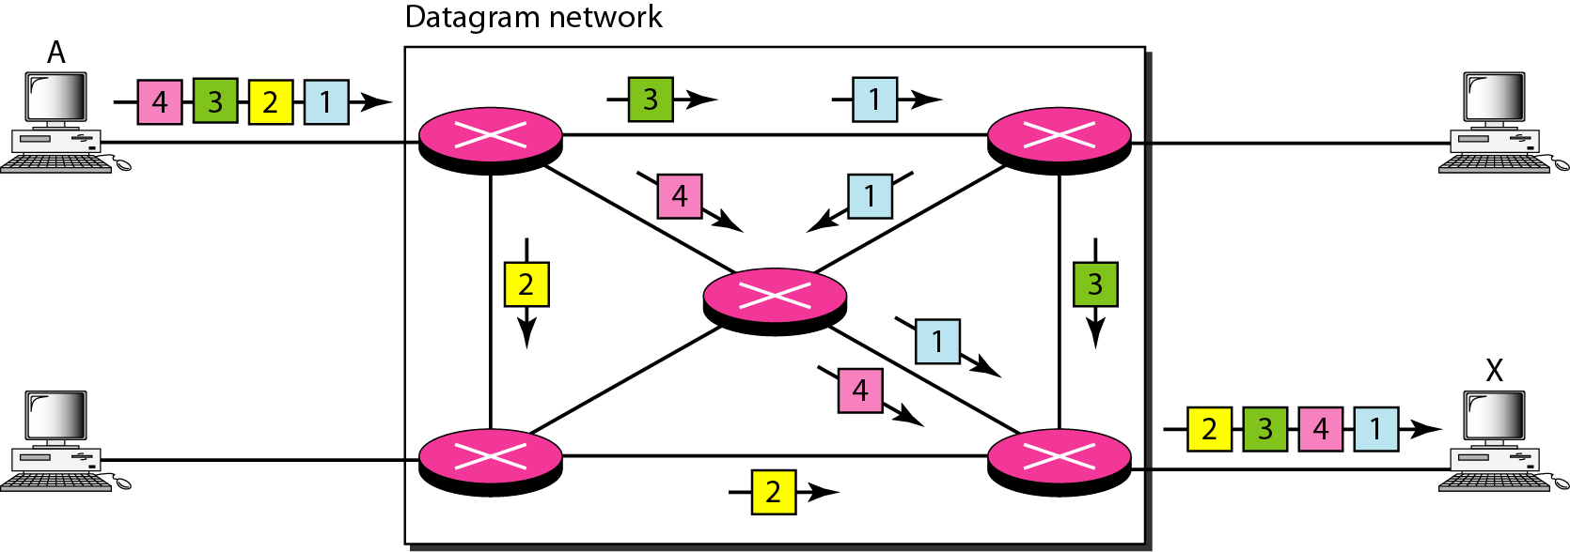
Figure 8.7 A datagram network with four switches (routers)

Slide 4
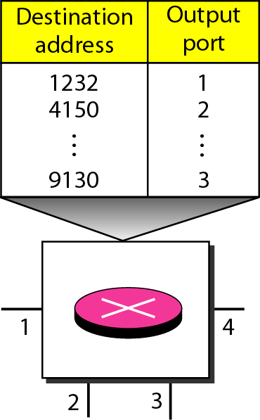
Figure 8.8 Routing table in a datagram network

Slide 5
Note
A switch in a datagram network uses a routing table that is based on the destination address.

Slide 6
Note
The destination address in the header of a packet in a datagram network
remains the same during the entire journey of the packet.

Slide 7
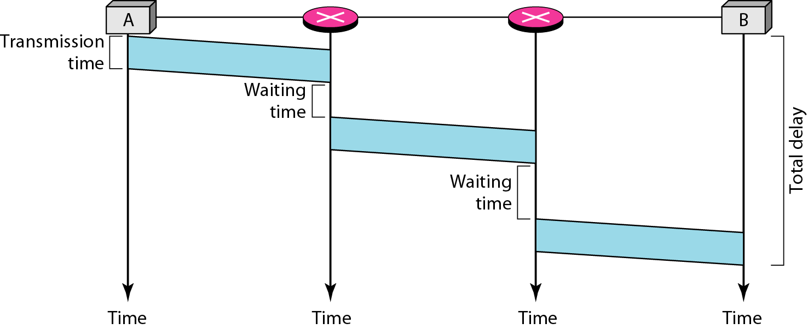
Figure 8.9 Delay in a datagram network

Slide 8
Note
Switching in the Internet is done by using the datagram approach to packet switching at the network layer.

Slide 9
VIRTUAL-CIRCUIT NETWORKS
A virtual-circuit network is a cross between a circuit-switched network and a datagram network. It has some characteristics of both.
Topics discussed in this section:
Addressing Three Phases
Efficiency Delay
Circuit-Switched Technology in WANs

Slide 10
VIRTUAL-CIRCUIT NETWORKS
As in a circuit-switched network, there are setup and teardown phases in addition to the data transfer phase.
Resources can be allocated during the setup phase, as in a circuit-switched network, or on demand, as in a datagram network.
As in a datagram network, data are packetized and each packet carries an address in the header. However, the address in the header has local jurisdiction (it defines what should be the next switch and the channel on which the packet is being carried), not end-to-end jurisdiction.

Slide 11
VIRTUAL-CIRCUIT NETWORKS
As in a circuit-switched network, all packets follow the same path established during the connection.
A virtual-circuit network is normally implemented in the data link layer, while a circuit-switched network is implemented in the physical layer and a datagram network in the network layer. But this may change in the future.
IMP:A source or destination can be a computer, packet switch, bridge, or any other device that connects other networks.

Slide 12
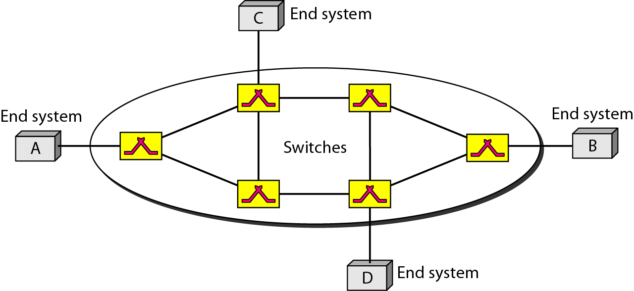
Figure 8.10 Virtual-circuit network

Slide 13
Addressing
Global Addressing
A source or a destination needs to have a global address-an address that can be unique in the scope of the network or internationally if the network is part of an international network.
a global address in virtual-circuit networks is used only to create a virtual-circuit identifier.

Slide 14
Addressing
Virtual-Circuit Identifier
The identifier that is actually used for data transfer is called the virtual-circuit identifier (VCI).
A VCI, unlike a global address, is a small number that has only switch scope; it is used by a frame between two switches.
When a frame arrives at a switch, it has a VCI; when it leaves, it has a different VCl.

Slide 15
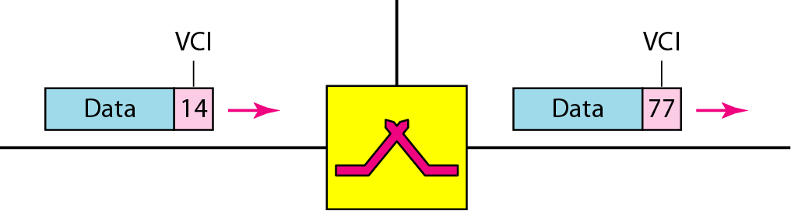
Figure 8.11 Virtual-circuit identifier

Slide 16
Three Phases
As in a circuit-switched network, a source and destination need to go through three phases in a virtual-circuit network: setup, data transfer, and teardown.
In the setup phase, the source and destination use their global addresses to help switches make table entries for the connection.
In the teardown phase, the source and destination inform the switches to delete the corresponding entry.
Data transfer occurs between these two phases.

Slide 17
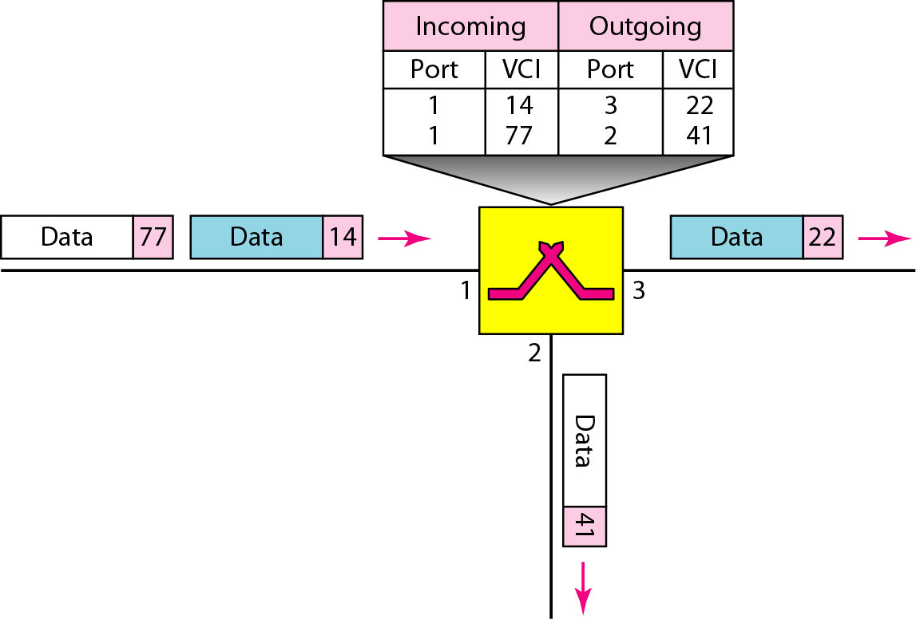
Figure 8.12 Switch and tables in a virtual-circuit network

Slide 18
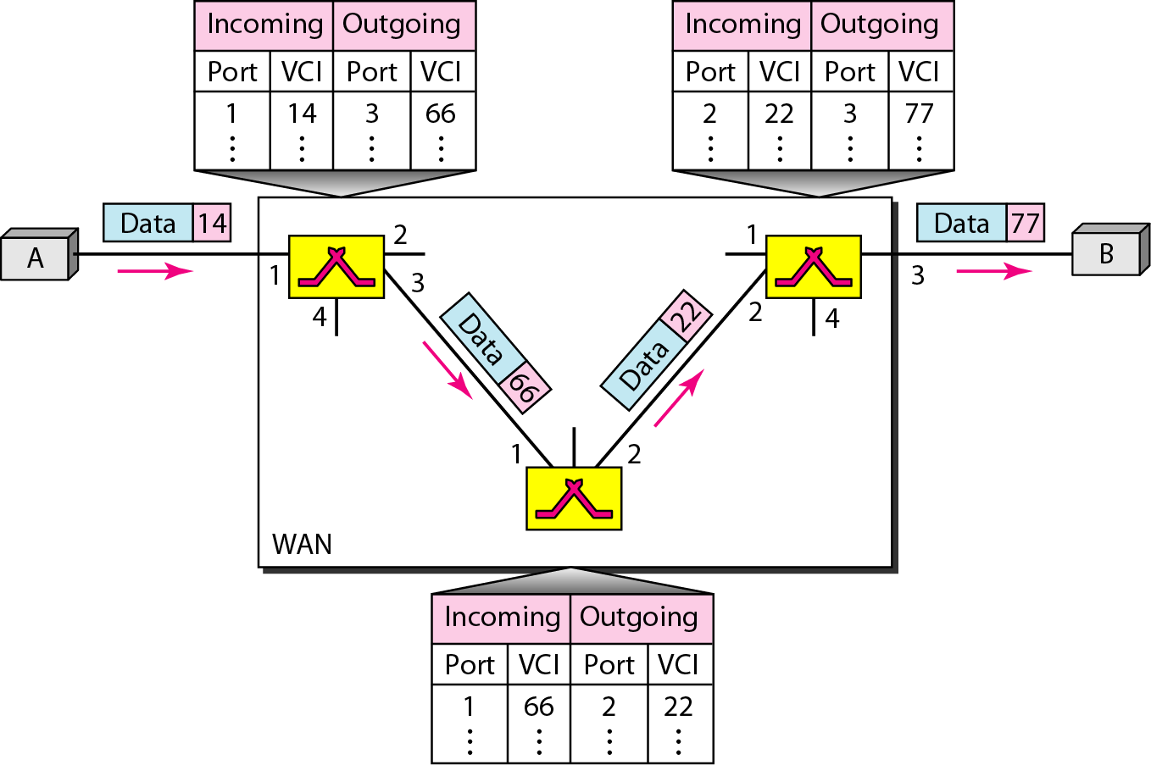
Figure 8.13 Source-to-destination data transfer in a virtual-circuit network

Slide 19
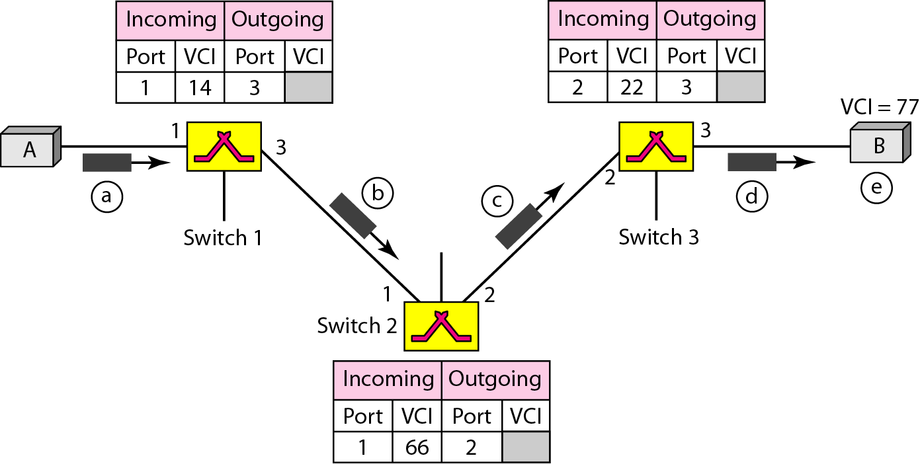
Figure 8.14 Setup request in a virtual-circuit network

Slide 20
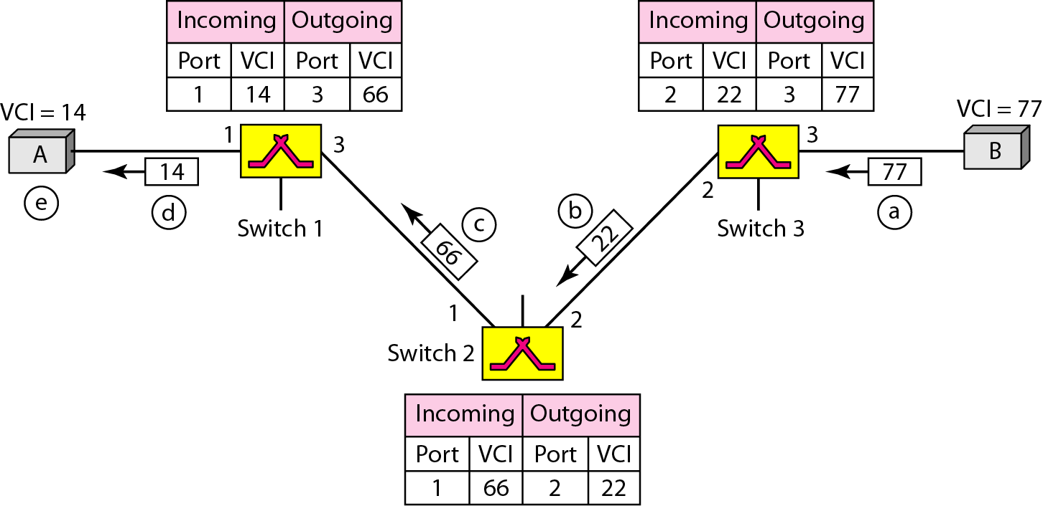
Figure 8.15 Setup acknowledgment in a virtual-circuit network

Slide 21
Efficiency
resource reservation in a virtual-circuit network can be made during the setup or can be on demand during the data transfer phase.
In virtual-circuit switching, all packets belonging to the same source and destination travel the same path;but the packets may arrive at the destination with different delays if resource allocation is on demand.
There is one big advantage in a virtual-circuit network even if resource allocation is on demand.
The source can check the availability of the resources, without actually reserving it.

Slide 22
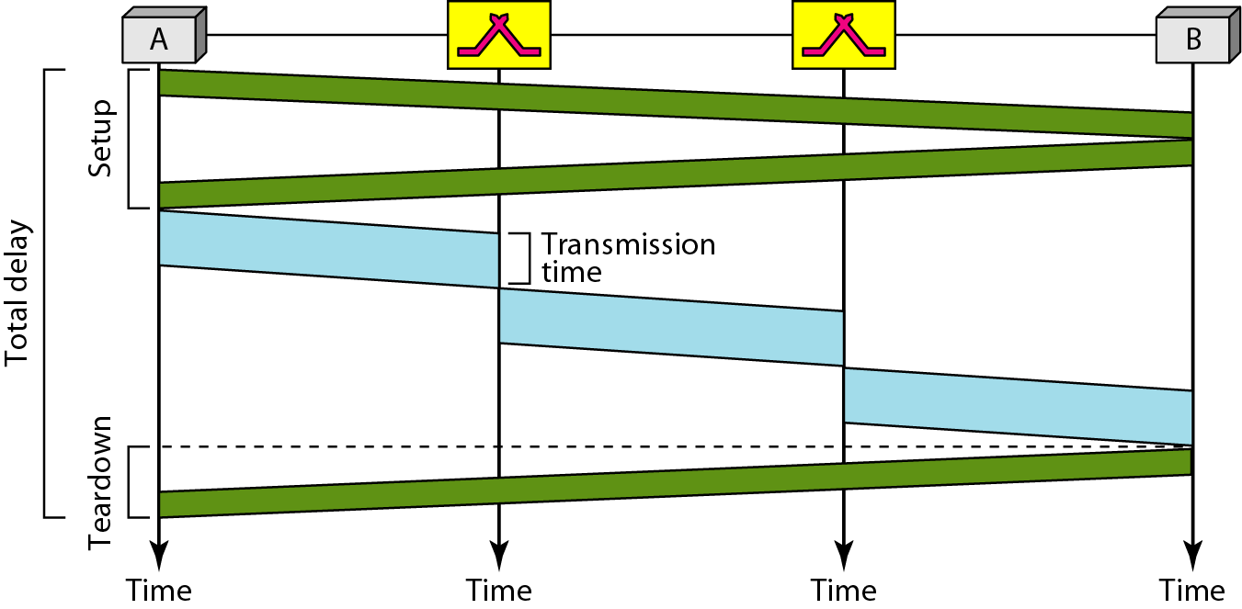
Figure 8.16 Delay in a virtual-circuit network

Slide 23
Note
Switching at the data link layer in a switched WAN is normally
implemented by using virtual-circuit techniques.

